Slide 1


HAS THE INCREASE IN AIR POLLUTION AFFECTED THE WEATHER IN NORTH AND SOUTH AMERICA?
Team 7

Slide 2


OVERVIEW ABOUT THE PROJECT
Who will it benefit?
Governments
Everyone

Slide 3





Data Summary
CSV files
Mean population exposure to PM2.5 air pollution (2010-2020)
Population data (2010-2020)
API
Weather Data by season (Max temp, wind speed, humidity)
CSV files
Latitude and Longitude of cities in North and South America
API
Location of coal plants in North and South America

Slide 4





Data Summary
,Mexico
United States
Canada
Colombia
Chile

Slide 5
Data Preparation Process
Obtain an Api key
Obtain base URL and parameters needed
Iterate through the Data Frame
Create new lists and add new values to the main Dataframes
Latitude
Longitude
Date
2 Data Frames since North and South America have different dates for their seasons
New lists for temperature, humidity and wind speed (1 list per parameter per year)
No data cleaning required in this step since the API successfully returned values for all year for all seasons for all latitudes and longitudes

Slide 6
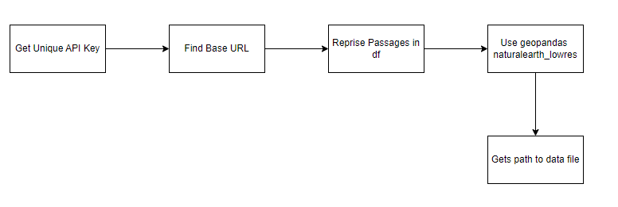
Data Preparation Process

Slide 7
Analysis Questions
1.Has the humidity and temperature been affected by an increase in PM2.5 air pollution?
2.In Countries, does the number of coal plants correlate with their respective air pollution percentages?
3.Are cities with a higher population more affected by PM2.5 air pollution?
4. Is the air pollution worse in North or South America?
5. Is wind speed affected by PM2.5 air pollution?
6. Are cities with the highest population affected highest level of PM2.5 pollution

Slide 8
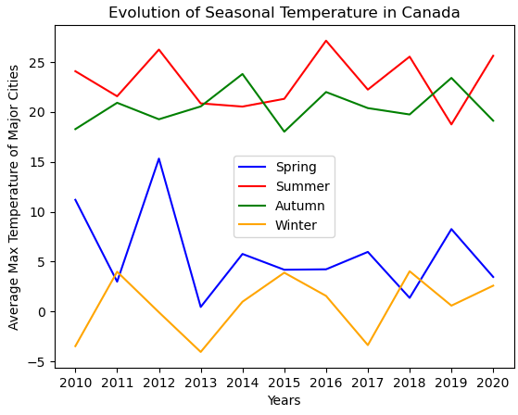
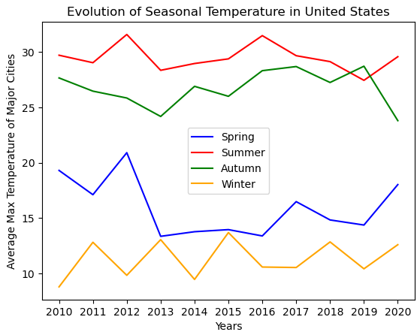
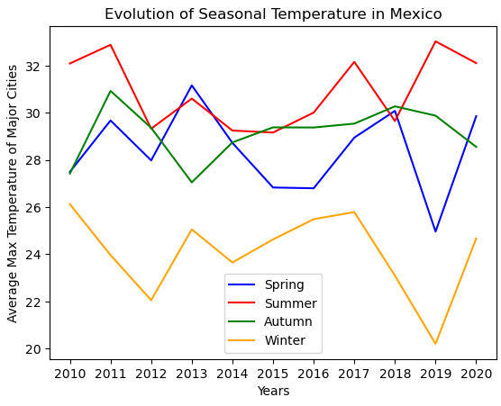
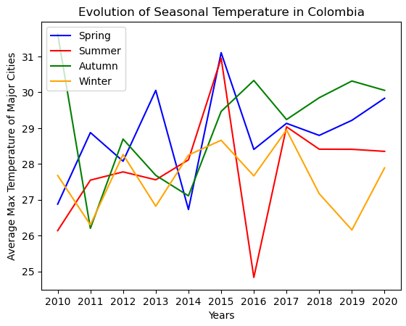
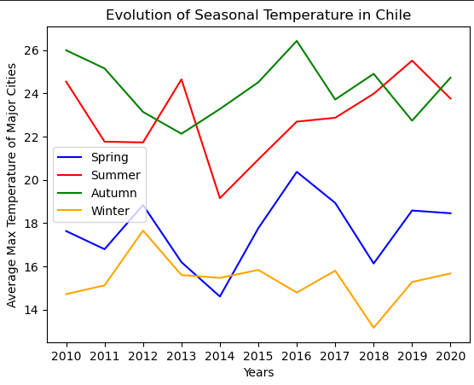
Has the humidity and temperature been affected by an increase in PM2.5 air pollution?
Evolution of Seasonal Temperature

Slide 9
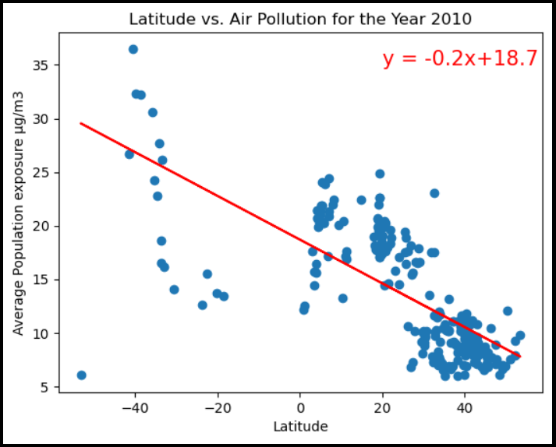
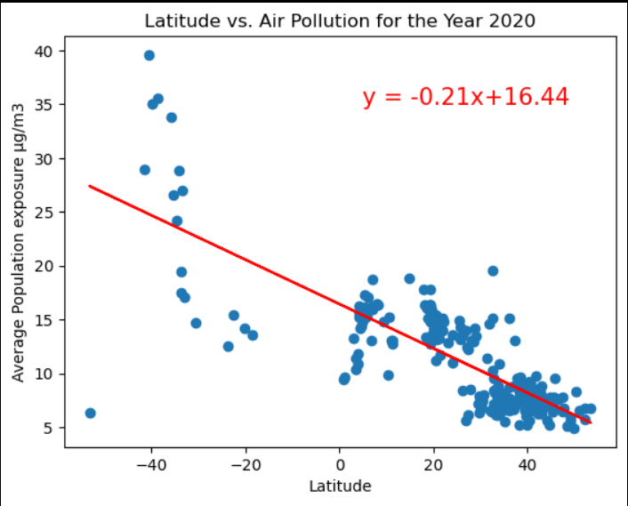
Does your location influence any changes in exposure to PM2.5 air pollution?
Relationship between Latitude and Air Pollution

Slide 10
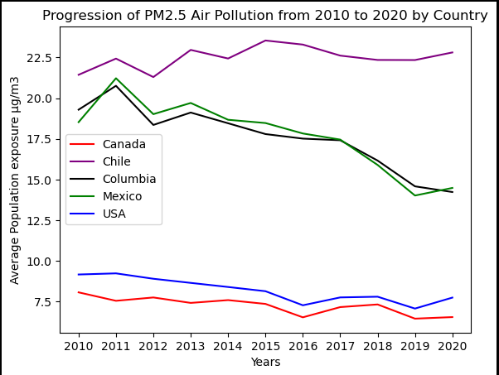
How has the PM2.5 air pollution changed over the years?
Evolution of Average pollution exposure to PM2.5

Slide 11
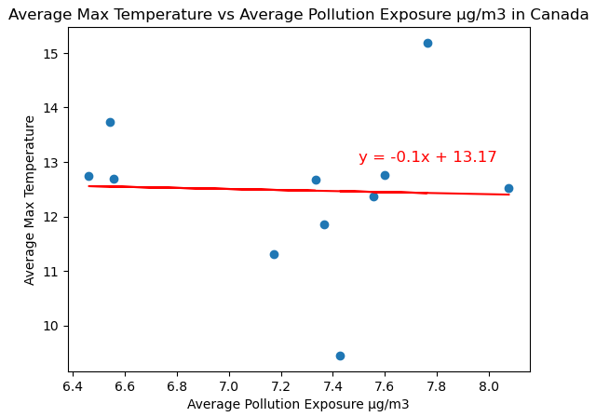
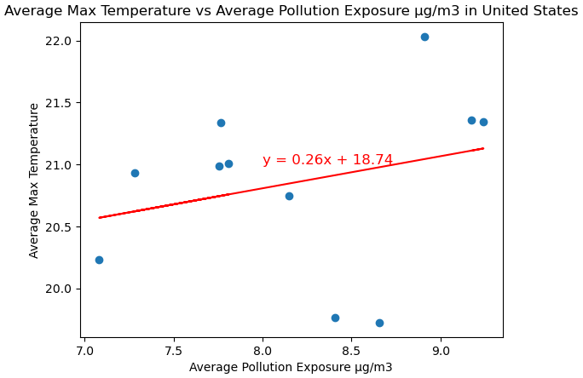
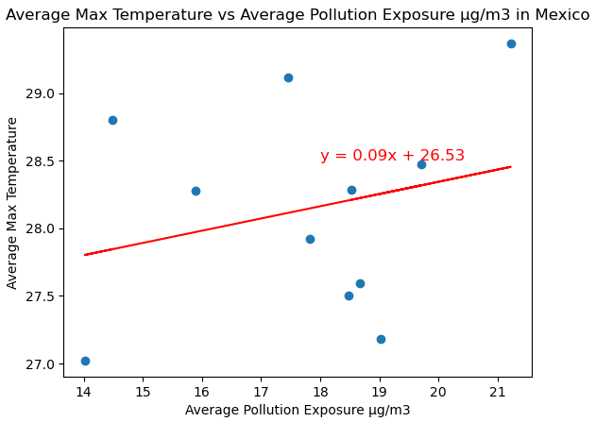
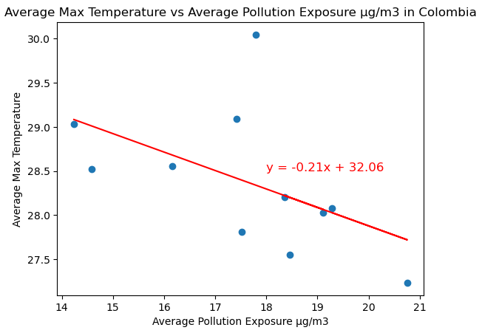
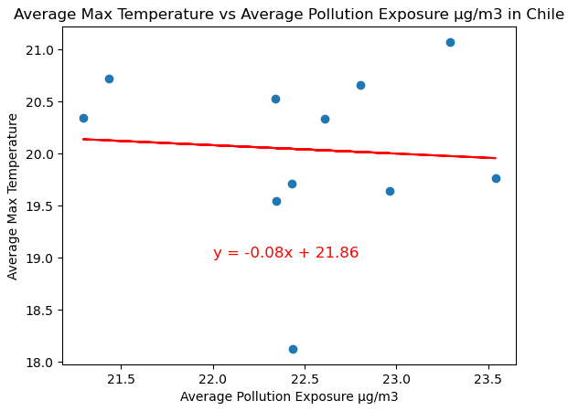
Has the humidity and temperature been affected by an increase in PM2.5 air pollution?
Relationship between Air Pollution and Temperature
Correlation=-0.04
Correlation=0.27
Correlation=0.26
Correlation=-0.52
Correlation=-0.07

Slide 12
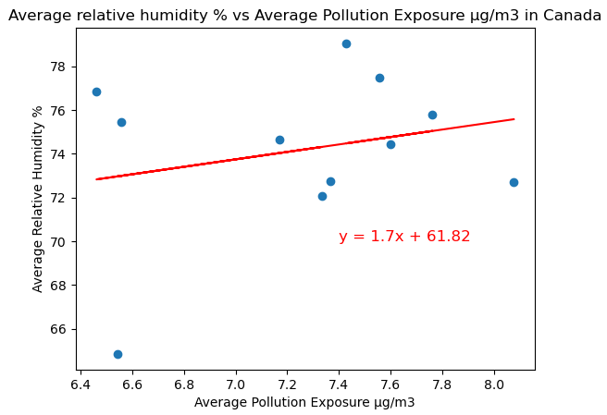
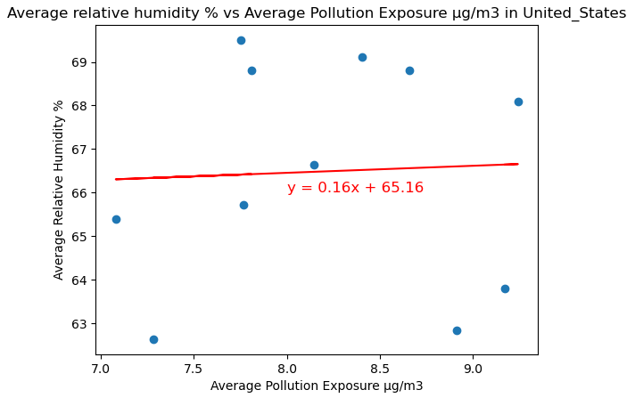
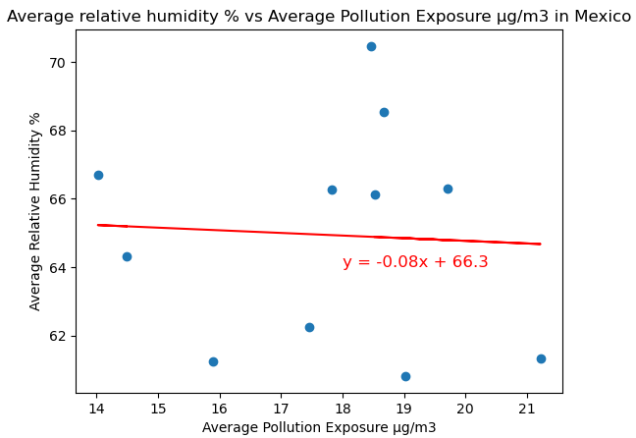
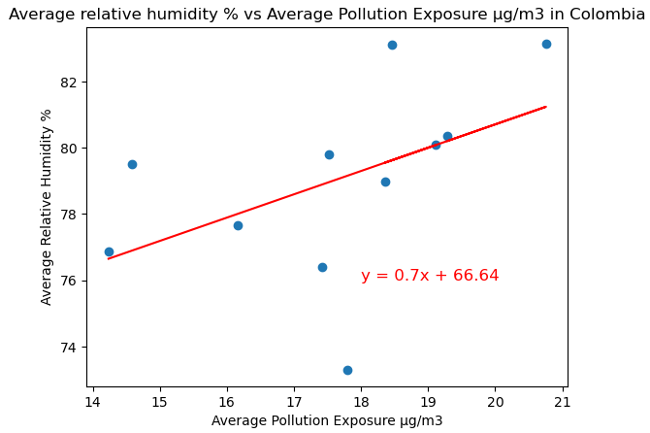
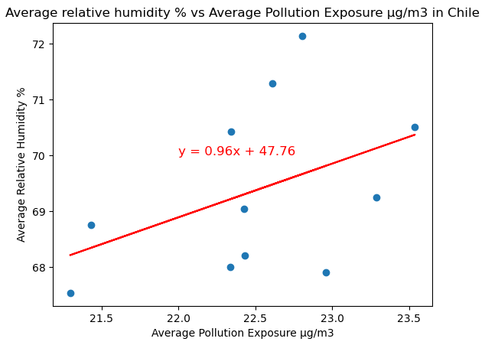
Has the humidity and temperature been affected by an increase in PM2.5 air pollution?
Relationship between Air Pollution and Humidity
Correlation=0.05
Correlation=-0.05
Correlation=0.24
Correlation=0.48
Correlation=0.43

Slide 13
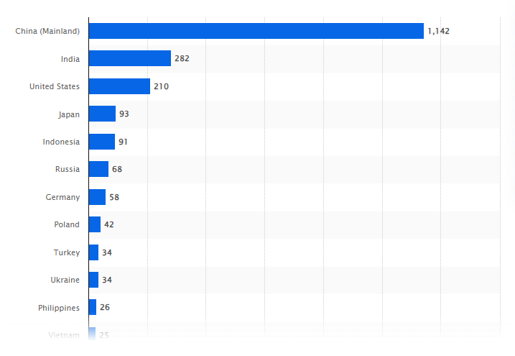
Comparative Analysis: Coal Plants & Pollution
There is a high variance in amount between different Countries
Is it a leading factor in air pollution?

Slide 14
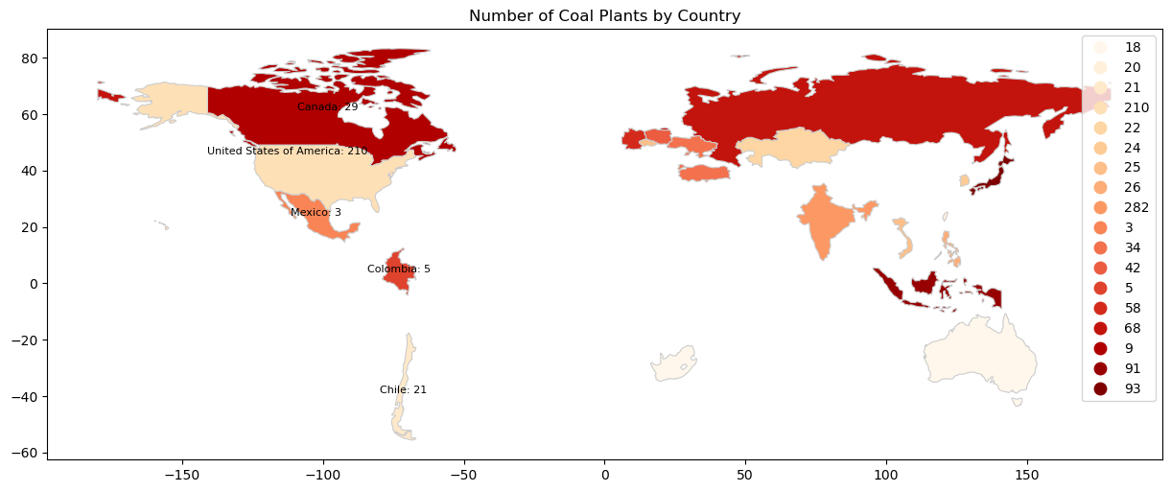
Number of Coal Powered Plants by Country
CN 29, US 210, MX 3, CL 5, CH 21

Slide 15
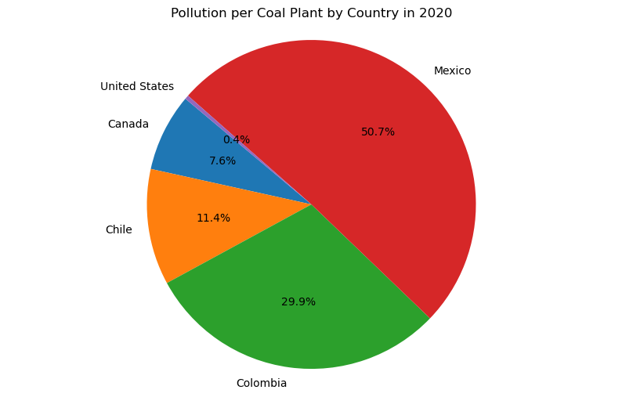
Pollution Compared per Powered Plant by Country
CN 29, US 210, MX 3, CL 5, CH 21

Slide 16
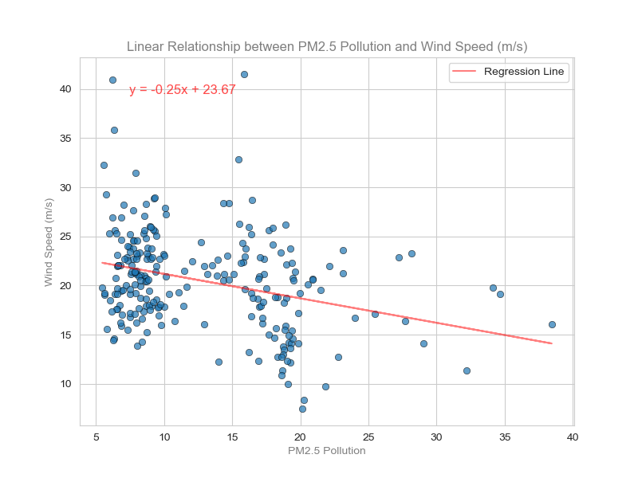
Is wind speed affected by PM2.5 air pollution in the case of the five cities?
Hypothesis:
Null Hypothesis (H0):
There is no significant linear relationship
between PM2.5 pollution level and
wind speed.
Alternative Hypothesis (H1):
There is significant linear relationship
between PM2.5 pollution level and
wind speed.

Slide 17
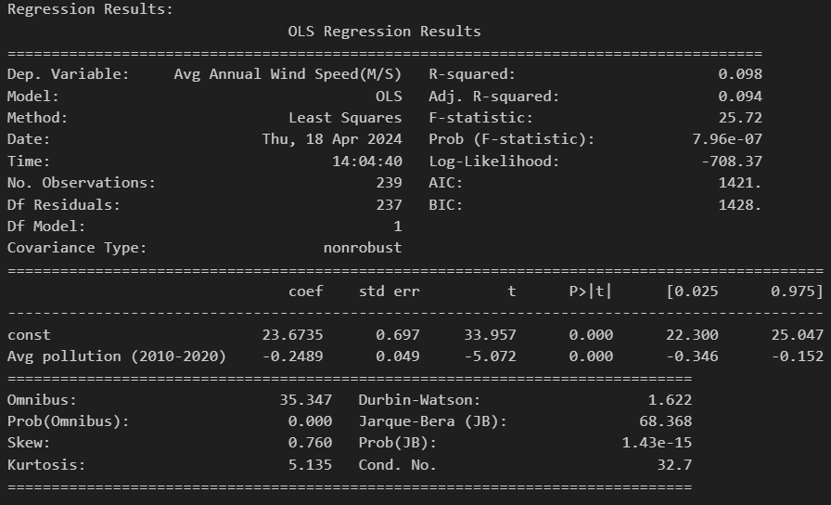

Slide 18
Regression result summary
Finding:
The R-squared value of 0.098 indicates that approximately 9.8% of the variability in wind speed can be explained by pollution levels.
p-value = 7.96e-07, which is less than the conventional significance level of 0.05.
Conclusion:
The regression model suggests that there is a statistically significant negative relationship between pollution levels and wind speed.
Therefore, With such a small p-value, we reject the null hypothesis.

Slide 19
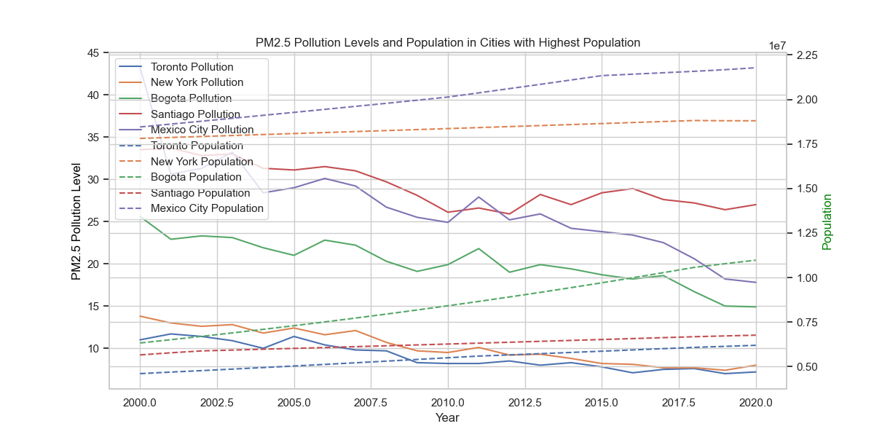
Are cities with the highest population experienced highest level of PM2.5 pollution
Trend analysis findings:
Population: upward trend in
population for all cities over
the years.
Pollution Levels: show fluctuations
over the years.

Slide 20
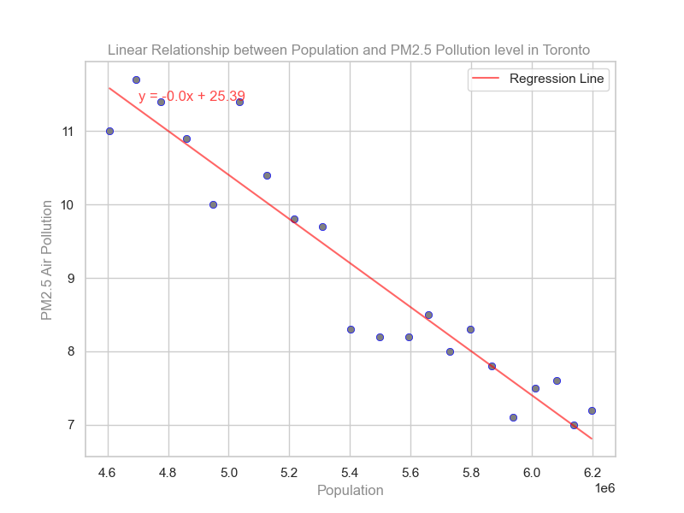
Regressions analysis
Hypothesis:
Null Hypothesis (H0):
There is no significant linear relationship
between the population of Toronto and
the pollution levels in Toronto.
Alternative Hypothesis (H1):
There is a significant linear relationship
between the population of Toronto and
the pollution levels in Toronto.

Slide 21
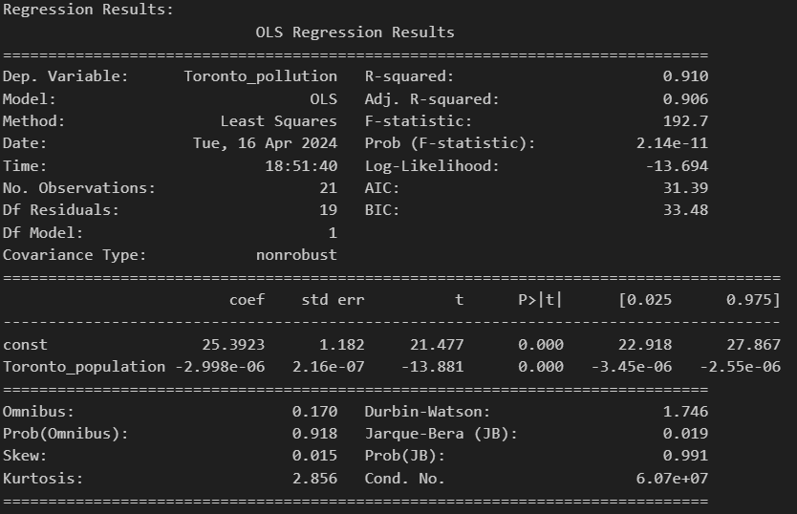
Regressions Result
Finding:
R-squared value is 0.910, which means that
approximately 91.0% of the variance in
Toronto_pollution is explained by the
Toronto_population.
The p-value is 0.001, which is less than the
typical significance level of 0.05.
Conclusion:
Therefore, we reject the null hypothesis and conclude that there is a significant linear relationship between the population of Toronto and the pollution levels in Toronto.

Slide 22
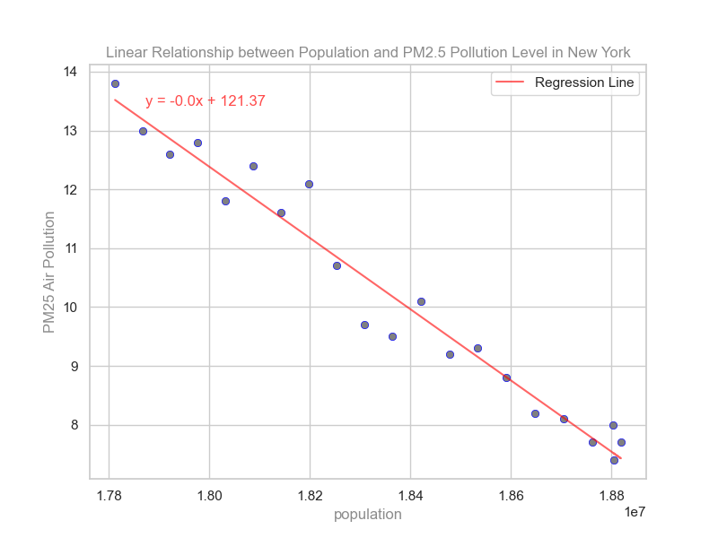
Regressions analysis
Hypothesis:
Null Hypothesis (H0):
There is no significant linear relationship
between the population of New York and
the pollution levels in New York.
Alternative Hypothesis (H1):
There is a significant linear relationship
between the population of New York and
the pollution levels in New York.

Slide 23

Regressions Result
Finding:
R-squared value is 0.962, which means that
approximately 96.2% of the variance in
New York pollution is explained by the
New York population.
The p-value is 0.001, which is less than the
typical significance level of 0.05.
Conclusion:
Therefore, we reject the null hypothesis and conclude that there is a significant linear relationship between the population of New York and the pollution levels in New York.

Slide 24
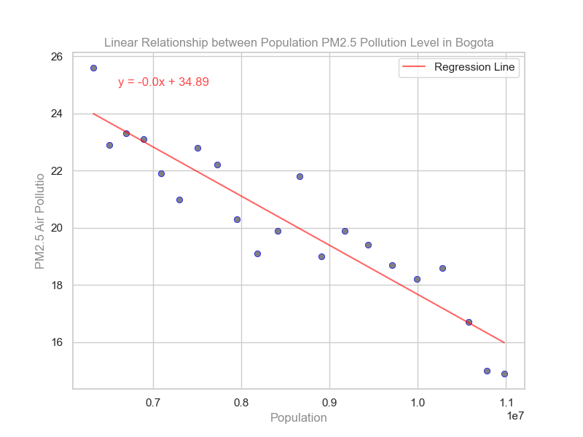
Regression analysis
Hypothesis:
Null Hypothesis (H0):
There is no significant linear relationship
between the population of Bogota and
the pollution levels in Bogota.
Alternative Hypothesis (H1):
There is a significant linear relationship
between the population of Bogota and
the pollution levels in Bogota.

Slide 25
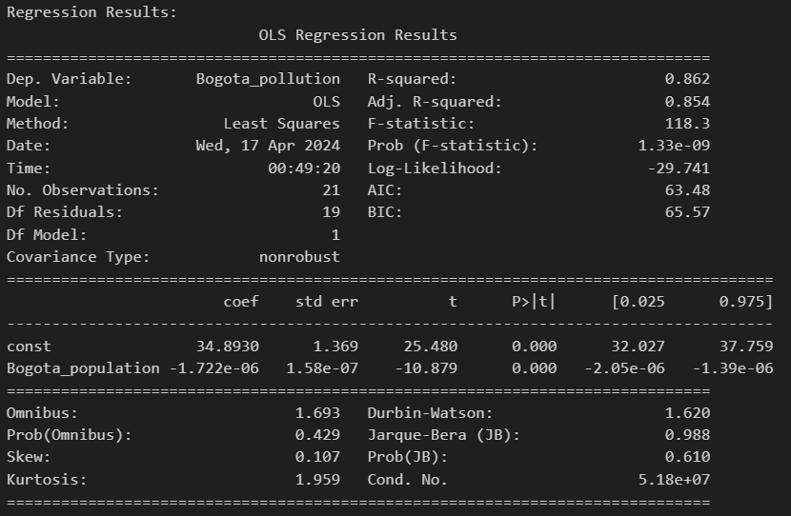
Regressions Result
Finding:
R-squared value is 0.862, which means that
approximately 86.2% of the variance in
Bogota pollution is explained by the
Bogota population.
The p-value is 0.001, which is less than the
typical significance level of 0.05.
Conclusion:
Therefore, we reject the null hypothesis and conclude that there is a significant linear relationship between the population of Bogota and the pollution levels in Bogota.

Slide 26
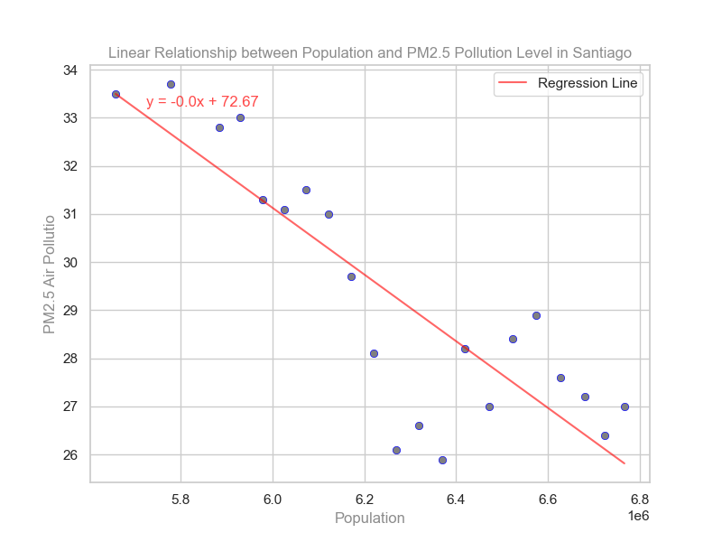
Regression analysis
Hypothesis:
Null Hypothesis (H0):
There is no significant linear relationship
between the population of Santiago and
the pollution levels in Santiago.
Alternative Hypothesis (H1):
There is a significant linear relationship
between the population of Santiago and
the pollution levels in Santiago.

Slide 27
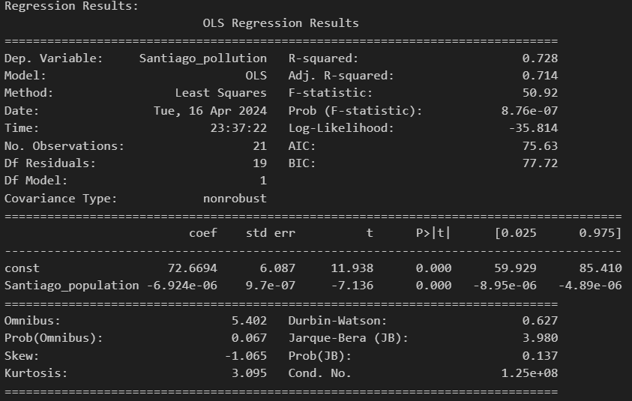
Regressions Result
Finding:
R-squared value is 0.728, which means that
approximately 72.8% of the variance in
Santiago pollution is explained by the
Santiago population.
The p-value is 0.001, which is less than the
typical significance level of 0.05.
Conclusion:
Therefore, we reject the null hypothesis and conclude that there is a significant linear relationship between the population of Santiago and the pollution levels in Santiago.

Slide 28
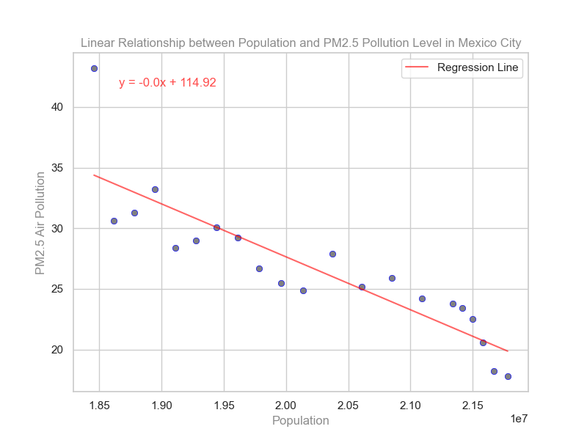
Regression analysis
Hypothesis:
Null Hypothesis (H0):
There is no significant linear relationship
between the population of Mexico City
and the pollution levels in Mexico City.
Alternative Hypothesis (H1):
There is a significant linear relationship
between the population of Mexico City
and the pollution levels in Mexico City.

Slide 29
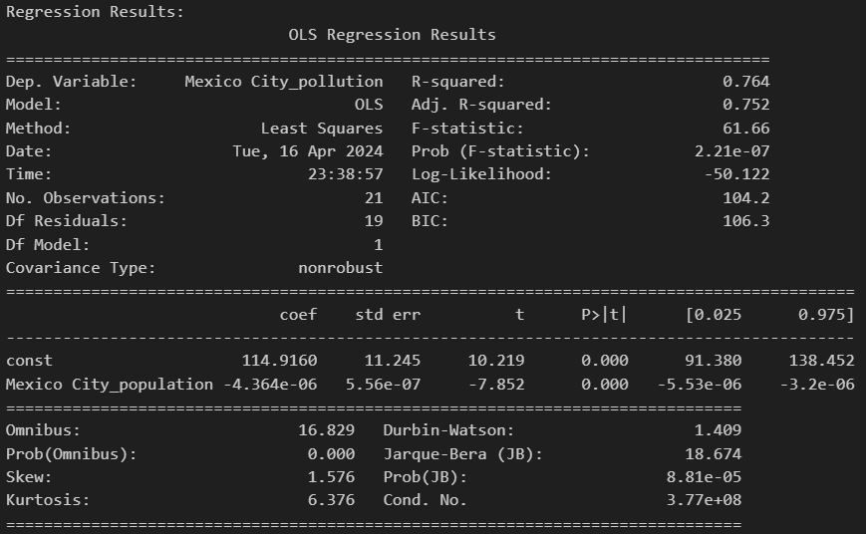
Regressions Result
Finding:
R-squared value is 0.764, which means that
approximately 76.4% of the variance in
Mexico City pollution is explained by the
Mexico City population.
The p-value is 0.001, which is less than the
typical significance level of 0.05.
Conclusion:
Therefore, we reject the null hypothesis and conclude that there is a significant linear relationship between the population of Mexico City and the pollution levels in Mexico City.

